Slide 1
Topic 1
Introduction to Computer
Notes:
Chapter 1 — Computer Abstractions and Technology
<number>

Slide 2
The Computer Revolution
Progress in computer technology
Moore’s Law
Makes novel applications feasible
Auto pilot vehicle
Cell phones
Robotic arms
Internet+
……
Computers are pervasive
Chapter 1 — Computer Abstractions and Technology — <number>
Notes:
Chapter 1 — Computer Abstractions and Technology
<number>

Slide 3
Classes of Computers
Desktop computers
General purpose, variety of software
Subject to cost/performance tradeoff
Embedded computers
Hidden as components of systems
Subject to power/performance/cost constraints
Server computers
Network based
High capacity, performance, reliability
Range from small servers to building sized
Chapter 1 — Computer Abstractions and Technology — <number>
Notes:
Chapter 1 — Computer Abstractions and Technology
<number>

Slide 4
Where can we find Computers
Desktop, Laptop, hand held PC, …
Automotive
Automatic Ignition Systems, Cruise, ABS, traction control, airbag release system…
Consumer Electronics
TV, PDA, appliances, toys, cell phones, camera …
Industrial Control
robotics, control systems …
Medical
Infusion Pumps, Dialysis Machines, Prosthetic Devices, Cardiac Monitors, …
Networking
wired and wireless routers, hubs, …
Office Automation
fax, photocopiers, printers, scanners, …
Aerospace applications
Flight-control systems, engine controllers, auto-pilots and passenger in-flight entertainment systems…
Defense systems
Radar systems, fighter aircraft flight-control systems, radio systems, and missile guidance systems…
Chapter 1 — Computer Abstractions and Technology — <number>

Slide 5
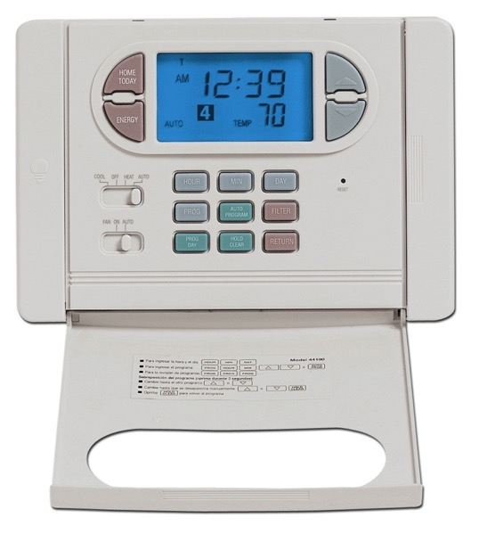
Product: Hunter Programmable Digital Thermostat.
Microprocessor: 4-bit
by Daniel W. Lewis
Chapter 1 — Computer Abstractions and Technology — <number>

Slide 6
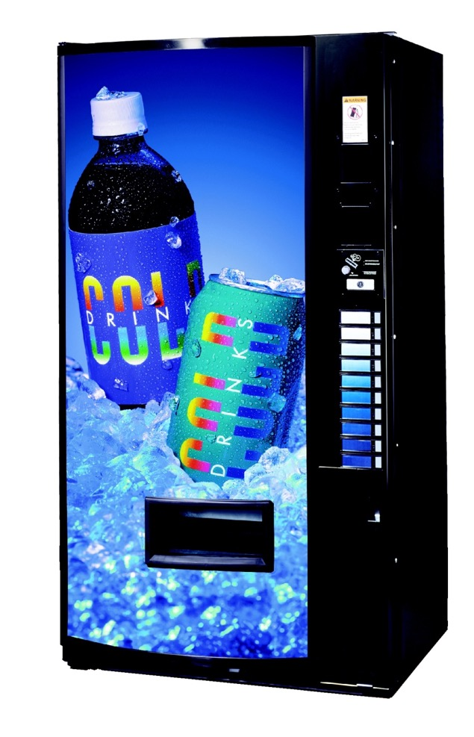
Product:Vendo V-MAX 720 vending machine.
Microprocessor: 8-bit Motorola 68HC11.
by Daniel W. Lewis
Chapter 1 — Computer Abstractions and Technology — <number>

Slide 7
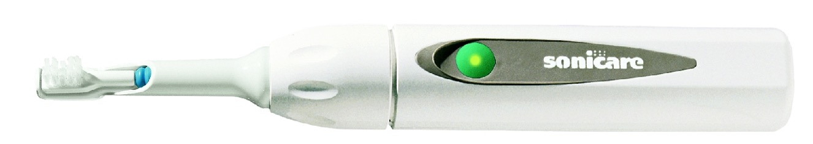
Product: Sonicare Plus toothbrush.
Microprocessor: 8-bit Zilog Z8.
by Daniel W. Lewis
Chapter 1 — Computer Abstractions and Technology — <number>

Slide 8
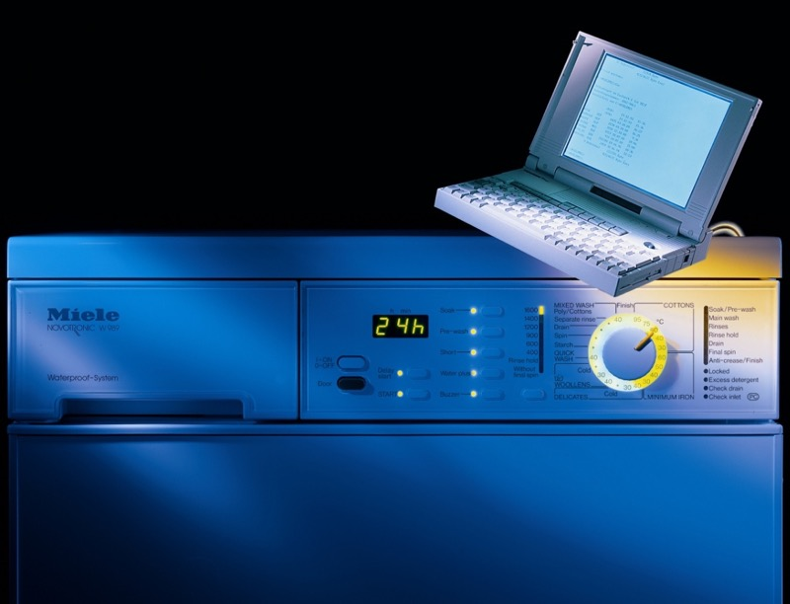
Product: Miele dishwashers. Microprocessor: 8-bit Motorola 68HC05.
by Daniel W. Lewis
Chapter 1 — Computer Abstractions and Technology — <number>

Slide 9
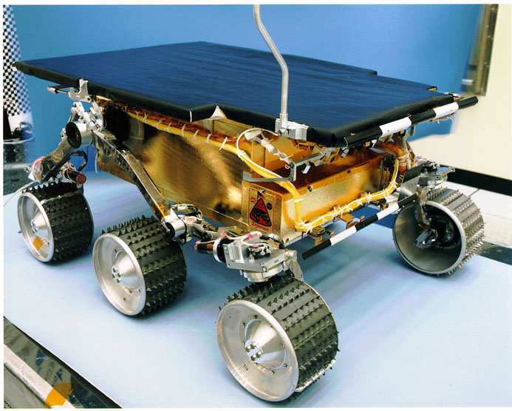
Product: NASA's Mars Sojourner Rover. Microprocessor: 8-bit Intel 80C85.
by Daniel W. Lewis
Chapter 1 — Computer Abstractions and Technology — <number>

Slide 10
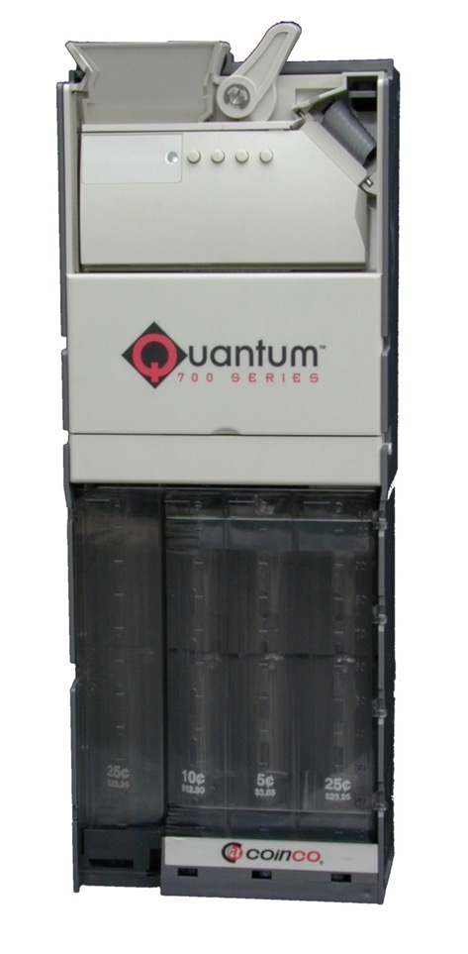
Product: CoinCo USQ-712 coin changer.
Microprocessor: 8-bit Motorola 68HC912.
by Daniel W. Lewis
Chapter 1 — Computer Abstractions and Technology — <number>

Slide 11
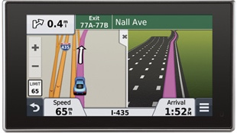
Product: Garmin Nüvi GPS Receiver Microprocessor: 32-bit.
Chapter 1 — Computer Abstractions and Technology — <number>

Slide 12
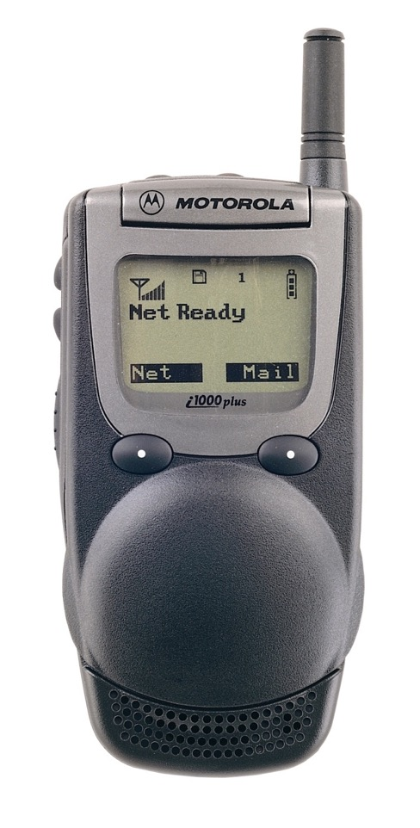
Product: Motorola i1000plus iDEN Multi-Service Digital Phone. Microprocessor: Motorola 32-bit MCORE.
by Daniel W. Lewis
Chapter 1 — Computer Abstractions and Technology — <number>

Slide 13
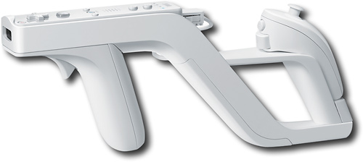

Product: Nintendo Wii Controller Microprocessor: IBM 32-bit Power RISC
Chapter 1 — Computer Abstractions and Technology — <number>

Slide 14
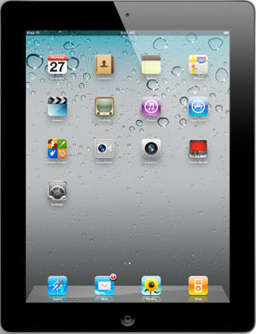
Product: Apple iPad Microprocessor: Apple A4, a 32-bit ARM RISC.
Chapter 1 — Computer Abstractions and Technology — <number>

Slide 15
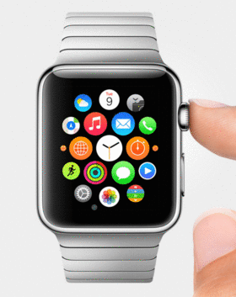
Product: Apple iWatch Microprocessor: 32-bit Apple A6 and M7 Coprocessor
Chapter 1 — Computer Abstractions and Technology — <number>

Slide 16
Product: HUAWEI P20 Pro Microprocessor: 8 64-bit ARMv8-A, the same architecture as iPhone X
by Daniel W. Lewis
Chapter 1 — Computer Abstractions and Technology — <number>

Slide 17
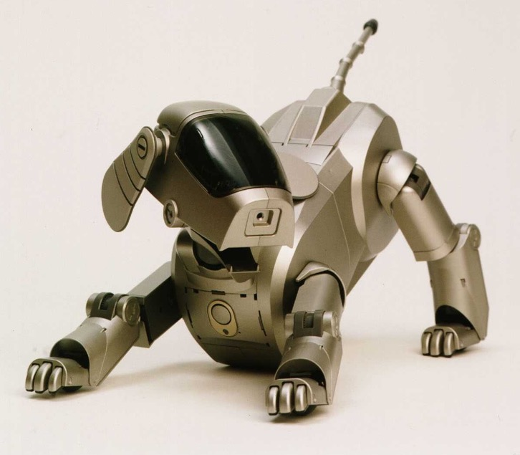
Product: Sony Aibo ERS-110 Robotic Dog. Microprocessor: 64-bit MIPS RISC.
by Daniel W. Lewis
Chapter 1 — Computer Abstractions and Technology — <number>

Slide 18
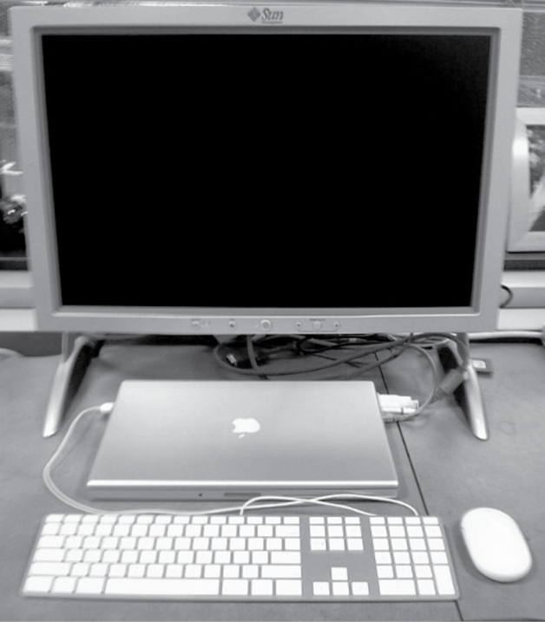
Anatomy of a Computer
Output device
Network cable
Input device
Input device
Chapter 1 — Computer Abstractions and Technology — <number>
Notes:
Chapter 1 — Computer Abstractions and Technology
<number>

Slide 19
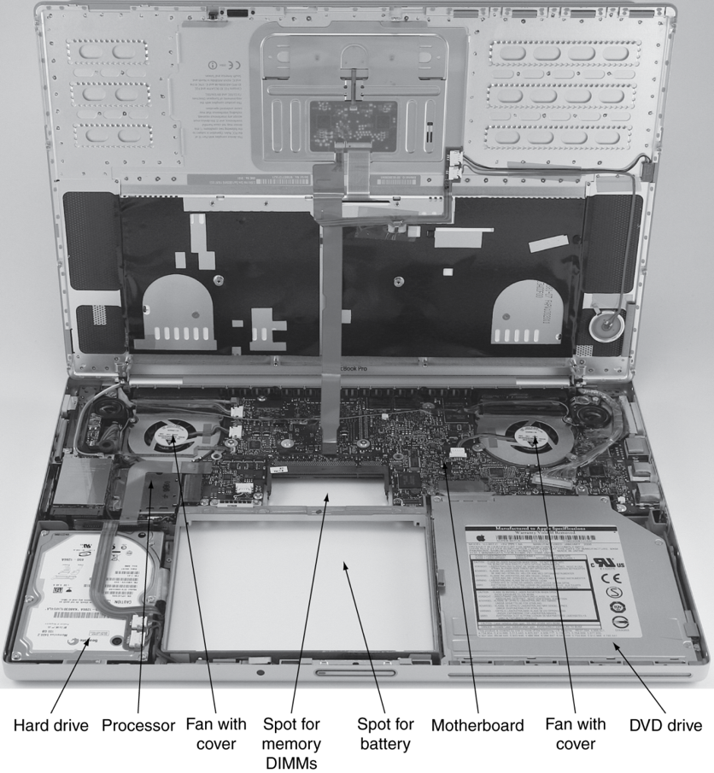
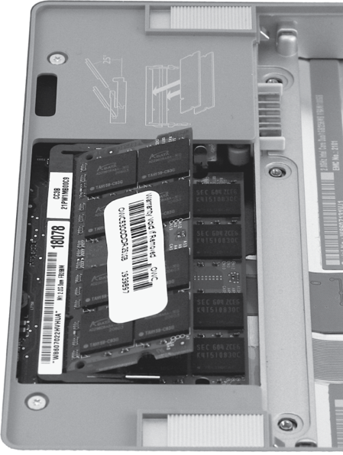
Opening the Box
Chapter 1 — Computer Abstractions and Technology — <number>
Dual-Inline-Memory-Modules
Notes:
Chapter 1 — Computer Abstractions and Technology
<number>

Slide 20
Inside the Processor (CPU)
Datapath: performs operations on data
Control: controls how data flows
Cache memory
Small fast SRAM memory for immediate access to data
Chapter 1 — Computer Abstractions and Technology — <number>
Notes:
Chapter 1 — Computer Abstractions and Technology
<number>

Slide 21
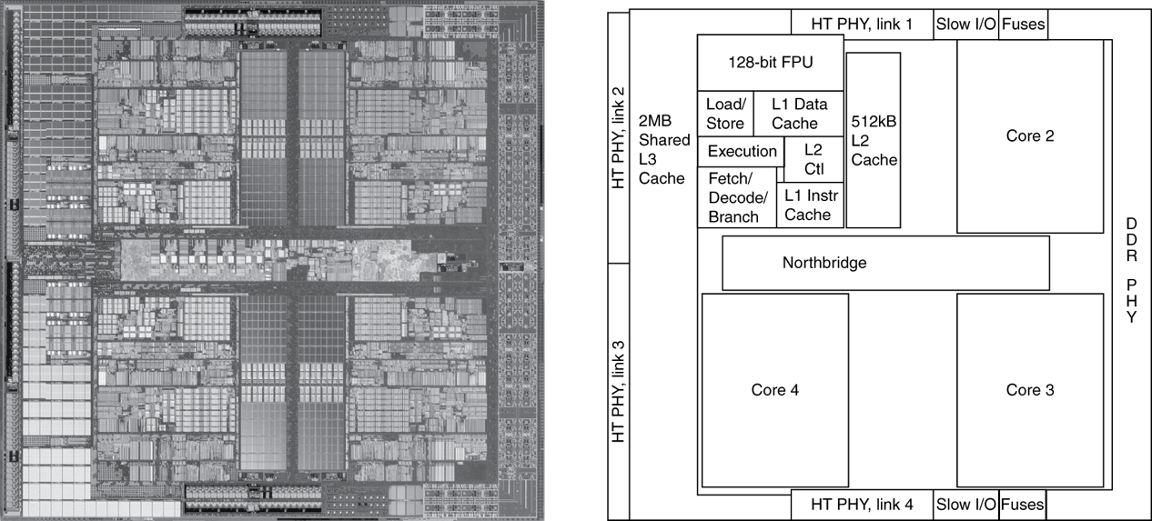
Inside the Processor
AMD Barcelona: 4 processor cores
Chapter 1 — Computer Abstractions and Technology — <number>
Notes:
Chapter 1 — Computer Abstractions and Technology
<number>

Slide 22
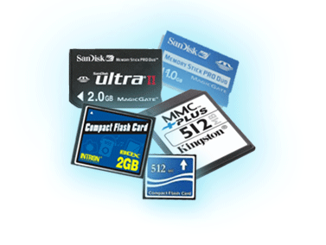
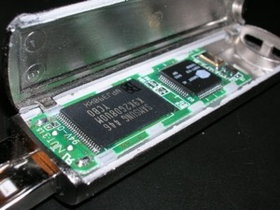
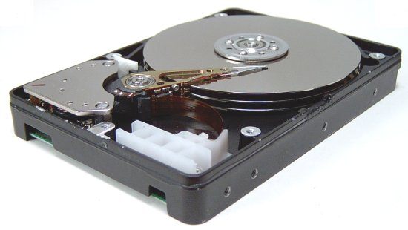
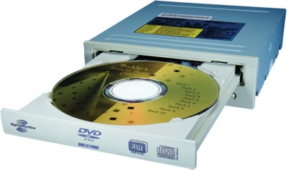
Peripheral – Memory
Volatile main memory
Loses instructions and data when power off
Non-volatile secondary memory
Magnetic disk
Flash memory
Optical disk (CDROM, DVD)
Chapter 1 — Computer Abstractions and Technology — <number>
Notes:
Chapter 1 — Computer Abstractions and Technology
<number>

Slide 23
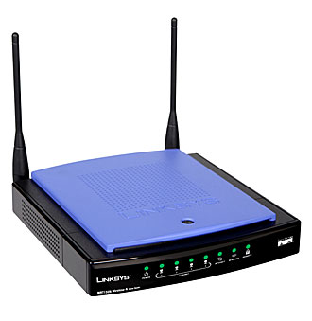
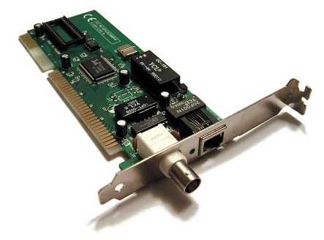
Peripheral – Networks
Communication and resource sharing
Local area network (LAN): Ethernet
Within a building
Wide area network (WAN): the Internet
Wireless network: WiFi, Bluetooth
Chapter 1 — Computer Abstractions and Technology — <number>
Notes:
Chapter 1 — Computer Abstractions and Technology
<number>

Slide 24
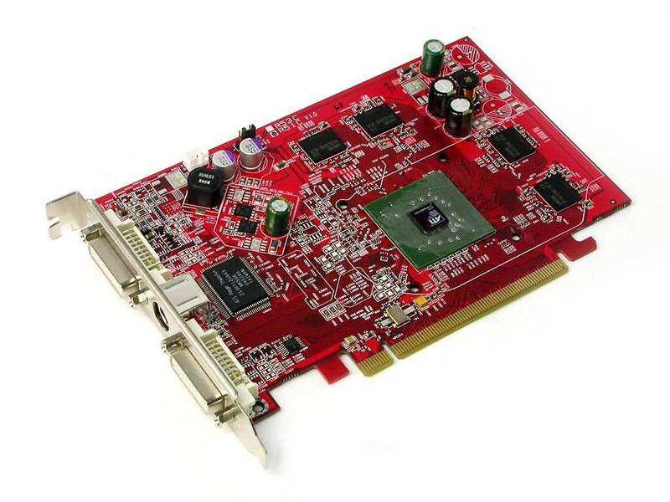
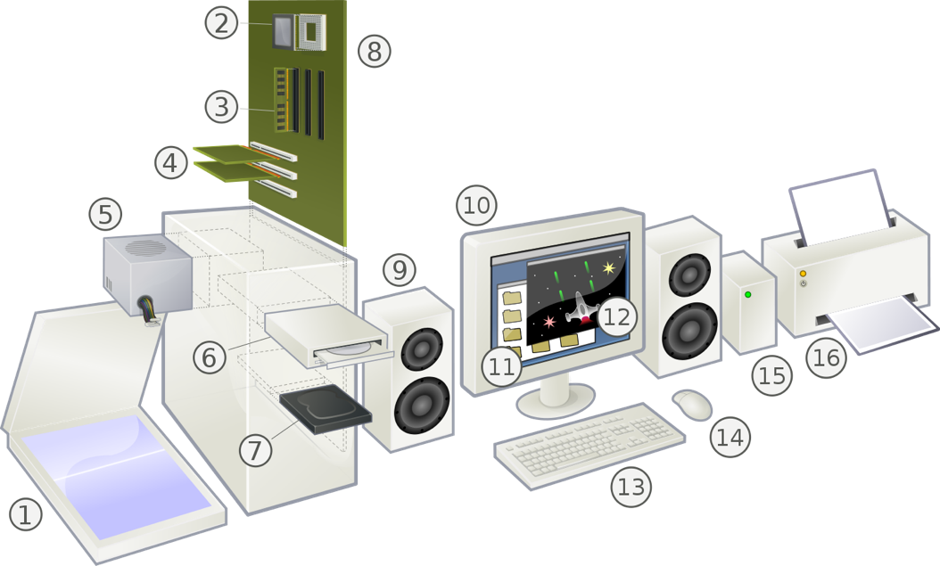
Peripheral – others
(Source: Wikipedia.org)
Chapter 1 — Computer Abstractions and Technology — <number>
Notes:
Chapter 1 — Computer Abstractions and Technology
<number>

Slide 25
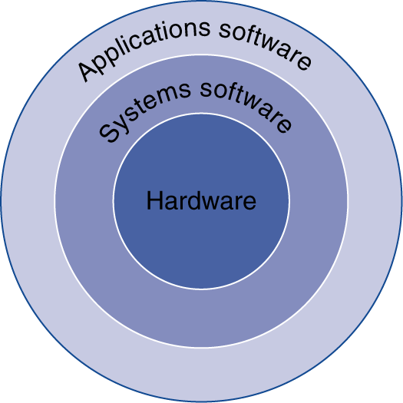
Together with Software
Application software
Written in high-level language (HLL)
System software / OS
Operating System: service code
Handling input/output
Managing memory and storage
Scheduling tasks & sharing resources
Written in C and assembly
Hardware
Processor, memory, I/O controllers
Chapter 1 — Computer Abstractions and Technology — <number>
Notes:
Chapter 1 — Computer Abstractions and Technology
<number>

Slide 26
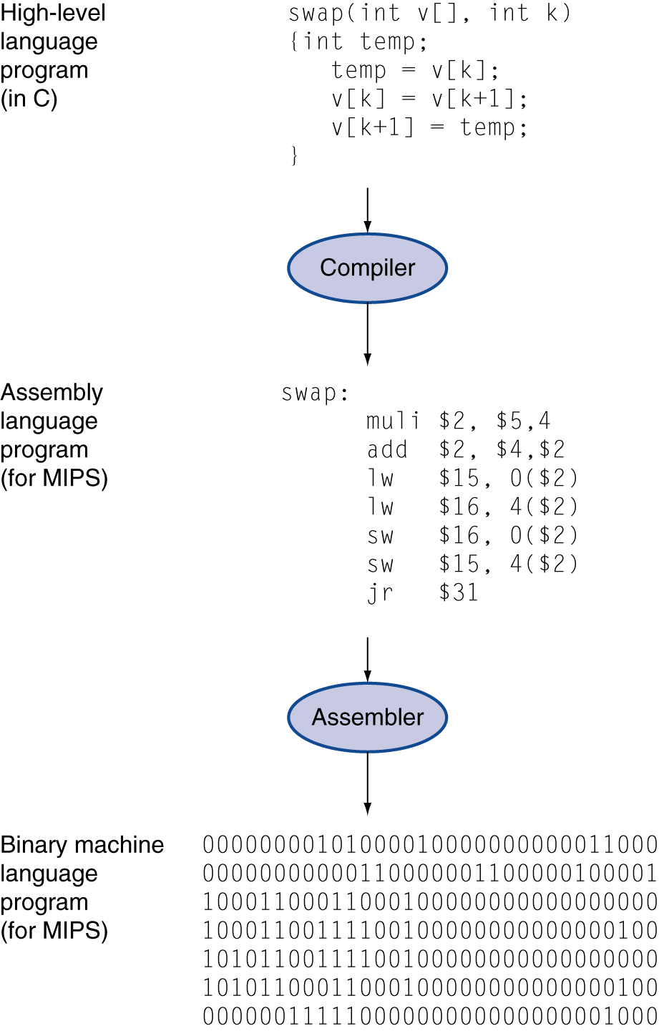
Levels of Program Code
High-level language
What we use
Assembly language
What both we and computers can use
Machine instruction
What computers use
socket
Chapter 1 — Computer Abstractions and Technology — <number>
Notes:
Chapter 1 — Computer Abstractions and Technology
<number>

Slide 27
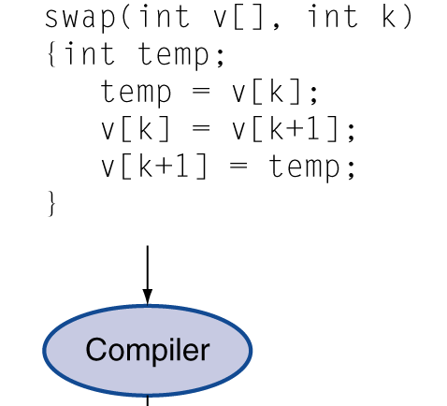
Levels of Program Code
High-level language
Syntax is similar to English
A translator is required to translate the program – compile
Allows the user to work on the program logic at higher level
Chapter 1 — Computer Abstractions and Technology — <number>
Notes:
Chapter 1 — Computer Abstractions and Technology
<number>

Slide 28
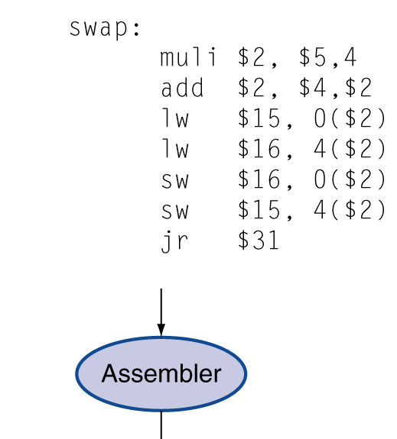
Levels of Program Code
Assembly language
Composed of assembly instructions
An assembly instruction is a mnemonic representation of a machine instruction
Assembly instruction must be translated before it can be executed – assembler
Programmers need to work on the program logic at a very low level, hard to achieve high productivity.
Chapter 1 — Computer Abstractions and Technology — <number>
Notes:
Chapter 1 — Computer Abstractions and Technology
<number>

Slide 29
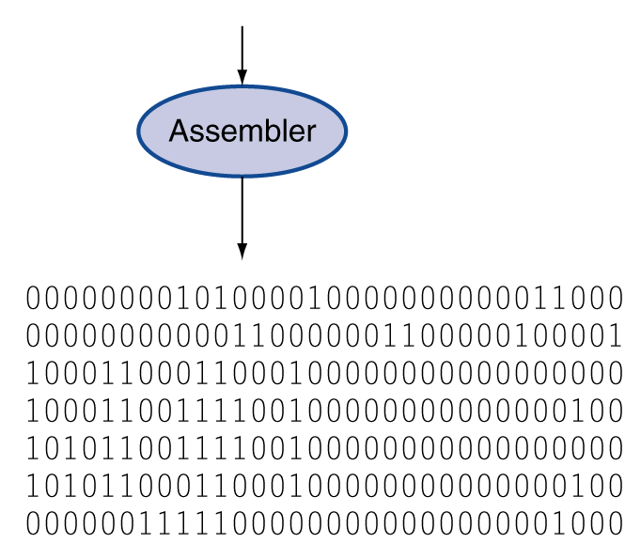
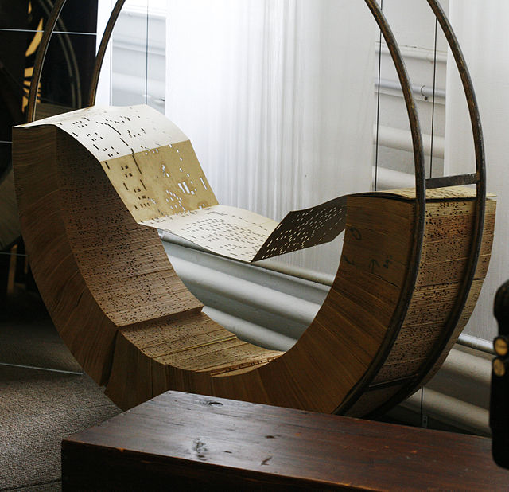
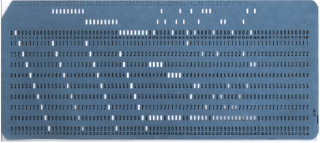
Levels of Program Code
Machine instruction
A sequence of binary digits which can be executed by the processor
Hard to understand, program, and debug for human being
From Wikipedia
Chapter 1 — Computer Abstractions and Technology — <number>
Notes:
Chapter 1 — Computer Abstractions and Technology
<number>

Slide 30
Technology Trends
Notes:
Chapter 1 — Computer Abstractions and Technology
<number>

Slide 31
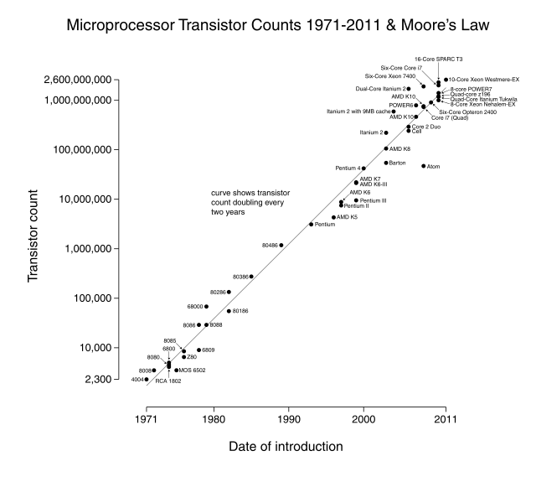
Technology Trends
Electronics technology continues to evolve
Reduced cost
Parallelism 并行
Low power
Increased capacity and performance
(From Wikipedia)
Chapter 1 — Computer Abstractions and Technology — <number>
Notes:
Chapter 1 — Computer Abstractions and Technology
<number>

Slide 32
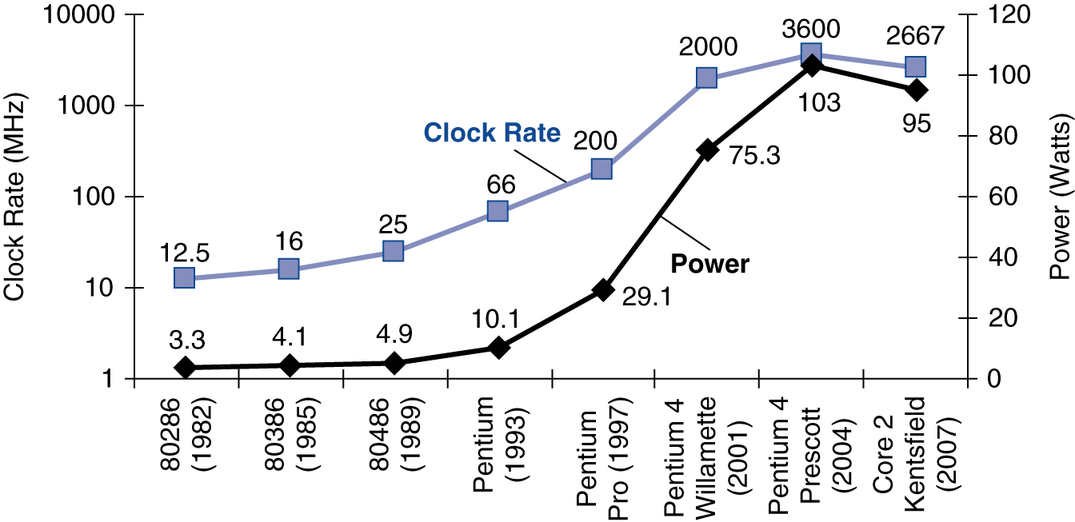
Power Trends
Cannot hanlde the heat problem
Hit the wall
In CMOS IC technology
×30
5V->1V in 15y, 15% off/generation
×1000
Chapter 1 — Computer Abstractions and Technology — <number>
Notes:
Chapter 1 — Computer Abstractions and Technology
<number>

Slide 33
How to Measure Computer Performance?
Execution (response) time
How long it takes to do a task
Measure for PCs and embedded computers
Throughput
Total work done per unit time
Servers
We’ll focus on execution time for now
Chapter 1 — Computer Abstractions and Technology — <number>
Notes:
Chapter 1 — Computer Abstractions and Technology
<number>

Slide 34
Measuring Performance - Time
Elapsed time – for System Performance
Total execution time to complete a task, including
Processing, I/O, OS overhead, idle time, everything
But doesn’t completely reflect computer’s performance if it focuses on better throughput
CPU time – for CPU Performance
CPU execution time processing a task
Exclude I/O time, time spent for other tasks
Comprises user CPU time and system CPU time
Hard to differentiate
Different programs run with different CPU performance and system performance
User must know what’s the desired performance metric
Chapter 1 — Computer Abstractions and Technology — <number>
Notes:
Chapter 1 — Computer Abstractions and Technology
<number>

Slide 35
Understanding Performance
Performance-related factors:
Algorithm
Determines number of operations executed
Programming language, compiler, architecture
Determine number of machine instructions executed per operation
Processor and memory system
Determine how fast instructions are executed
I/O system (including OS)
Determines how fast I/O operations are executed
Chapter 1 — Computer Abstractions and Technology — <number>
Notes:
Chapter 1 — Computer Abstractions and Technology
<number>

Slide 36
CPU Clocking
Operation of digital hardware governed by a constant-rate clock
Clock period
Clock (cycles)
Data transfer and computation
Update state
Chapter 1 — Computer Abstractions and Technology — <number>
Notes:
Chapter 1 — Computer Abstractions and Technology
<number>

Slide 37
CPU Time
Performance improved by
Reducing number of clock cycles
Increasing clock rate
Tradeoff we will face when designing the CPU
Chapter 1 — Computer Abstractions and Technology — <number>
Notes:
Chapter 1 — Computer Abstractions and Technology
<number>

Slide 38
CPU Time Example
Computer A: 2GHz clock, 10s CPU time
Designing Computer B
Aim for 6s CPU time
Can do faster clock, but causes 1.2 × clock cycles A
How fast must Computer B clock be?
Chapter 1 — Computer Abstractions and Technology — <number>
Notes:
Chapter 1 — Computer Abstractions and Technology
<number>

Slide 39
Instruction Count (IC) and Clock cycle Per Instruction (CPI)
How instructions related to performance?
Classic CPU
performance equation
Instruction Count for a program
Determined by program, Instruction Set Architecture (ISA), and compiler
Cycles per instruction
Determined by CPU hardware
If different instructions have different CPI
Average CPI, affected by instruction mix
Chapter 1 — Computer Abstractions and Technology — <number>
Notes:
Chapter 1 — Computer Abstractions and Technology
<number>

Slide 40
CPI Example
Computer A: Cycle Time = 250ps, CPI = 2.0
Computer B: Cycle Time = 500ps, CPI = 1.2
Same ISA
Which is faster, and by how much?
A is faster…
…by this much
Chapter 1 — Computer Abstractions and Technology — <number>
Notes:
Chapter 1 — Computer Abstractions and Technology
<number>

Slide 41
Performance Summary
The BIG Picture
Performance depends on
Algorithm: affects IC, possibly CPI
Programming language: affects IC, CPI
Compiler: affects IC, CPI
Instruction set architecture: affects IC, CPI, T_{c}
Chapter 1 — Computer Abstractions and Technology — <number>
Notes:
Chapter 1 — Computer Abstractions and Technology
<number>

Slide 42
Concluding Remarks
Classes and applications of computer
Cost/performance is improving
Due to underlying technology development
Hierarchical layers of abstraction
In both hardware and software
Execution time: the best performance measure
Power is a limiting factor
Use parallelism to improve performance
Chapter 1 — Computer Abstractions and Technology — <number>
Notes:
Chapter 1 — Computer Abstractions and Technology
<number>

